Slide 1

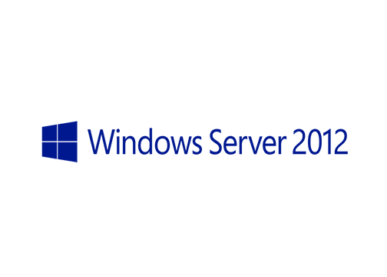
MegaSeries
Install and Configure Windows Deployment Services

Slide 2
Prerequisites
Have a new server installed and ready for the WDS role with a little more space on the C drive or a separate disk fpr the install images

Slide 3
Steps
Install the WDS role
Configure WDS
Import boot and install images
Make a test installation from the network

Slide 4
https://www.youtube.com/channel/UCcZ-jLbPwNr8E_v9-65n8Iw https://github.com/itknowledge4

